Slide 1

Department of Computer Engineering
Employee Management System
Mini Project Presentation
SADAB HUSSAIN – (92201703107) – EC2
MD ALIZAD– (92201703127) – EC2

Slide 2
Abstract
Introduction to Project
Tools and Technologies
Existing System
Proposed System
Screenshots
Conclusion
Contents

Slide 3
This documentation provides an introduction to Java and the use of JDBC (Java Database Connectivity), JFrame, and Swing components in the development of a Employee Management System. This project aims to demonstrate the practical application of Java in creating a user-friendly interface for user authentication and also demonstrate crud operation.
Abstract

Slide 4
Human resource difficulties face all businesses, large and small. Because every organization has different staff management needs, we create custom employee management solutions that are tailored to your needs. This is intended to aid strategic planning and guarantee that your firm has the appropriate degree of human resources to meet your long-term objectives. This approach will help you to better manage your resources in the long run.
This project aims to create a user-friendly Java application that allows users to log in securely and register new products. The application leverages Java Database Connectivity (JDBC) for database interaction and utilizes the Java Swing framework for creating the Graphical User Interface (GUI). The primary objectives of this project are to ensure data security, user authentication, and product registration in a simple and intuitive manner.
Introduction to Project

Slide 5
Table of Contents
Introduction to Java
1.1 What is Java?
1.2 Why Java?
Login and Employee Management System
2.1 Overview
2.2 Key Components
JDBC (Java Database Connectivity)
3.1 What is JDBC?
3.2 Connecting to a Database
3.3 Executing SQL Queries
JFrame
4.1 What is JFrame?
4.2 Creating a JFrame
4.3 Adding Components
Swing
5.1 Introduction to Swing
5.2 Building the User Interface
5.3 Event Handling
Tools and Technologies

Slide 6
Object-Oriented Programming (OOP)
JDBC (Java Database Connectivity)
Swing and Jframe
Exception Handling
GUI-Swing and Event Handling
Core Java Concepts used in Project

Slide 7
1.Employee Name Field
2. Adding New Employee Field
3. Category Dropdown
4. Add,Update,Delete ,View Button
5. Success Message Label
6. Error Message Label
Existing System

Slide 8
The proposed system aims to provide a user-friendly, secure, and efficient platform for users to log in and register . The system is designed to:
Enhance User Experience: Java Swing's rich GUI components provide a visually appealing and responsive interface, making it easier for users to interact with the system.
Secure User Data: JDBC ensures that user data is stored and retrieved securely from a database, safeguarding sensitive information.
Streamline Product Registration: The Employee Management System simplifies the process of adding new Employee to the system, enabling users to contribute efficiently.
Improve Data Integrity: Through JDBC, data consistency is maintained as all product registrations are recorded in the database.
Support Future Expansion: The modular design of the system allows for easy integration of additional features and functionalities.
Proposed System

Slide 9
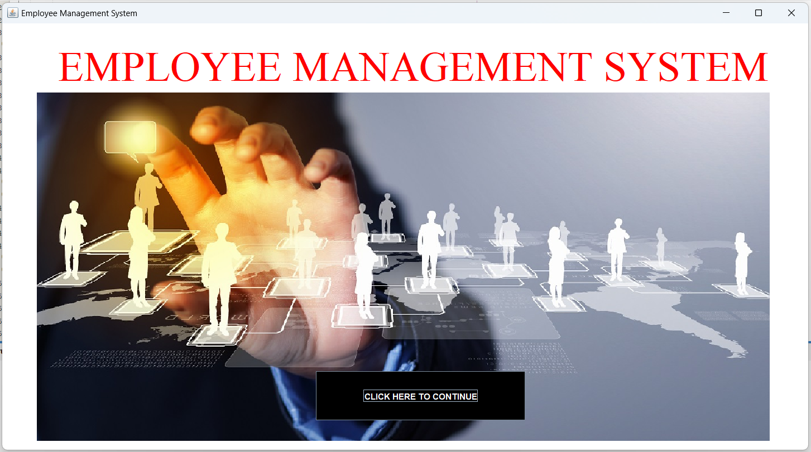
Landing Page

Slide 10
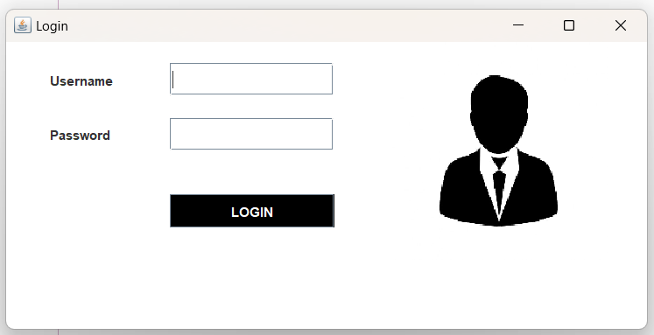
Login Page

Slide 11
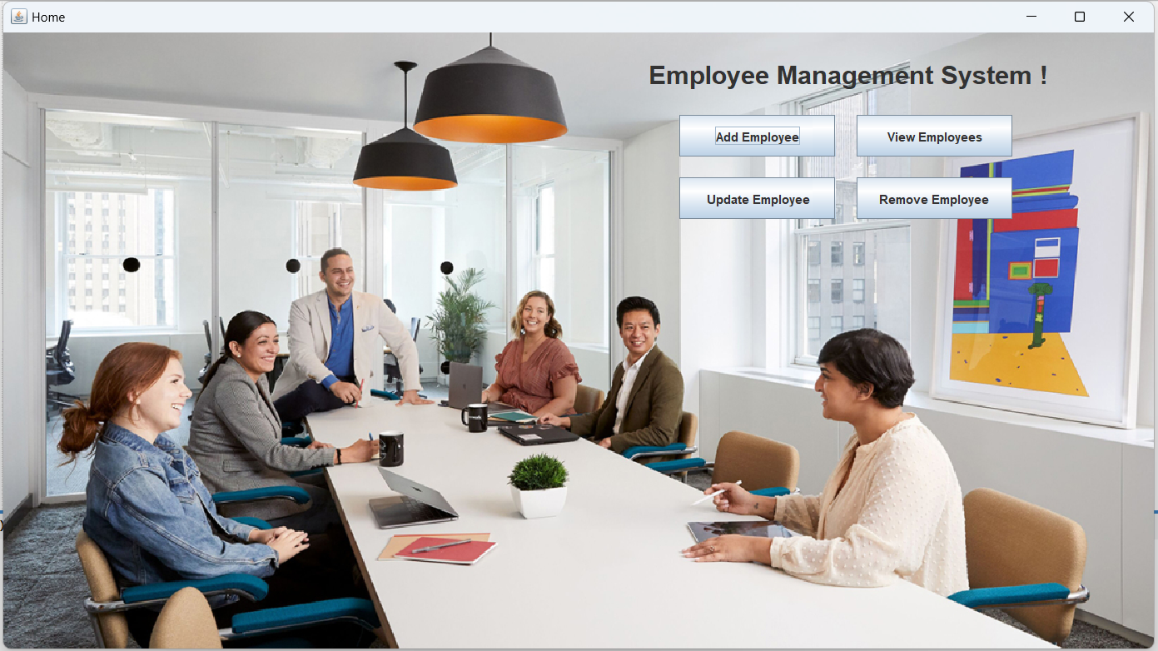
Home Page

Slide 12
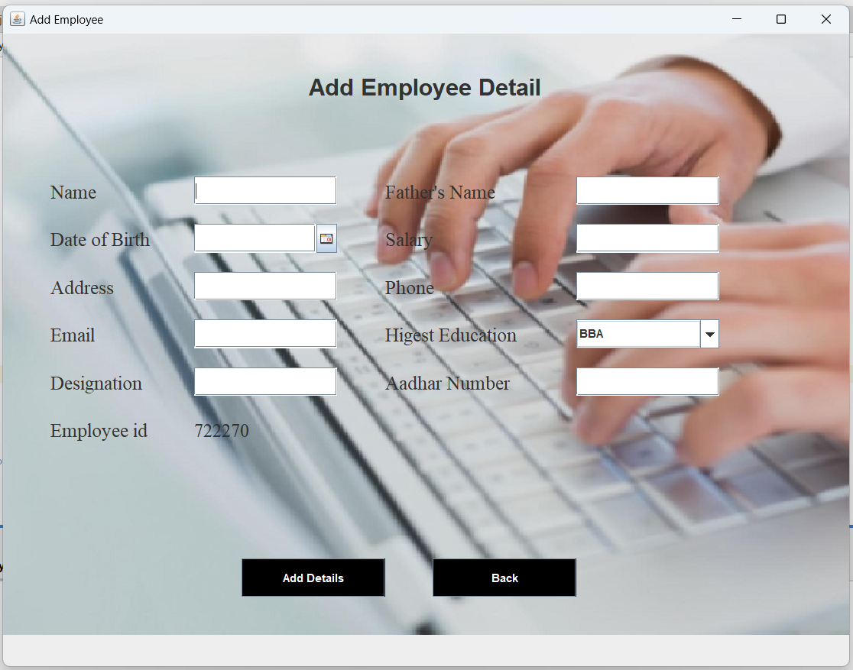
Add Employee

Slide 13
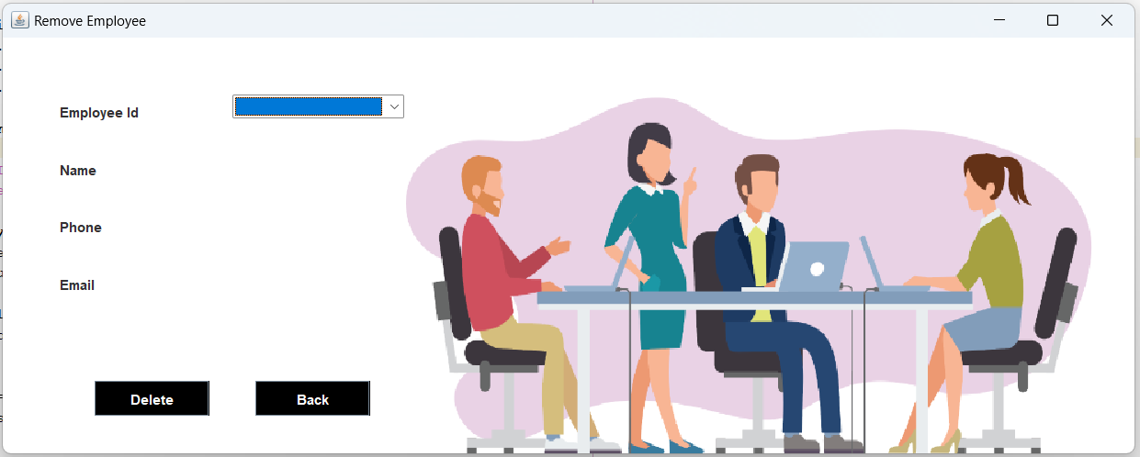
Remove
Employee

Slide 14
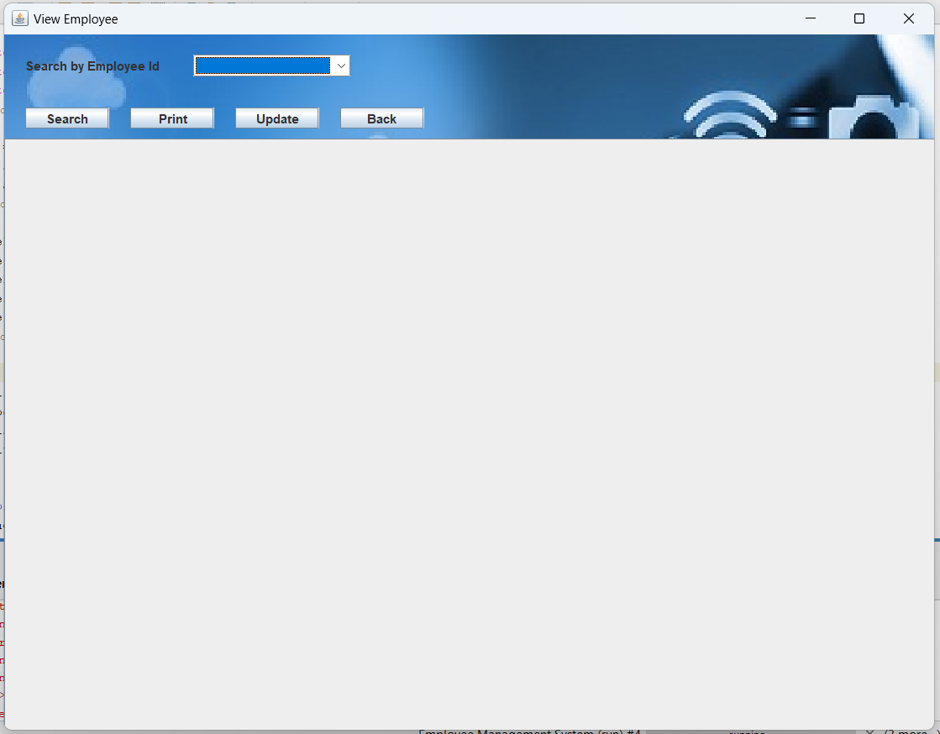
View Employee

Slide 15
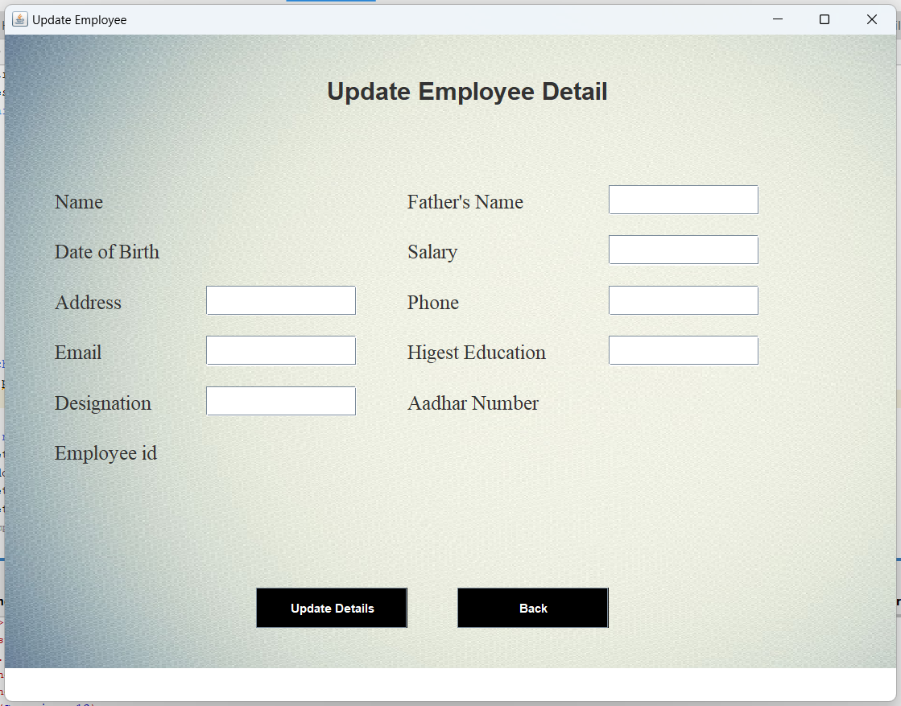
Update Employee

Slide 16
The goal of the initiative is to digitise personnel databases in businesses and provide administrators access to computers. Employees and administrators use software as an information system. The user can store his or her database safe and secure for an indefinite amount of time here. Adding, deleting, accessing, and changing employee information is simple and easy using the Employee Management System
Conclusion

Slide 17
[1] Axelrod, CW (2013). Managing the Risks of Cyber-Physical Systems. In 2013 Systems,
Applications and Technology Conf. (LISAT), pp. 1–6. IEEE: Long Island.
[2] www.researchgate.com/doc/library_management.
[3] Renae Broderick, John W. Boudreau, “Human resource management, information technology, and the competitive edge”, Academy of Management Executive, 1992 Vol. 6 No. 2.
[4] Avison, D. and Fitzgerald, G. (2003).Information systems Development Methodologies, Techniques and Tools.3rd Edition. McGraw-Hill Education Limited Bershire.
[5] Deitel, PJ & Deitel, HM, 2008, Internet & World Wide Web How to Program, Dorling Kindersley, India.
References

